Slide 1
Graphs
Definition and Traversals

Slide 2
Graphs
Problem Statement
A generic tool to abstract out problems
Problem Definition
Algorithm
“Implementation”
Analysis

Slide 3
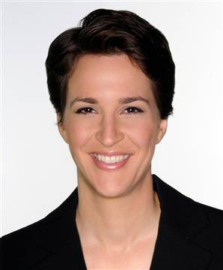






Graphs
Representation of relationships between pairs of entities/elements
Edge
Entities: News hosts
Relationship: Mention in other’s program
Vertex/Node

Slide 4
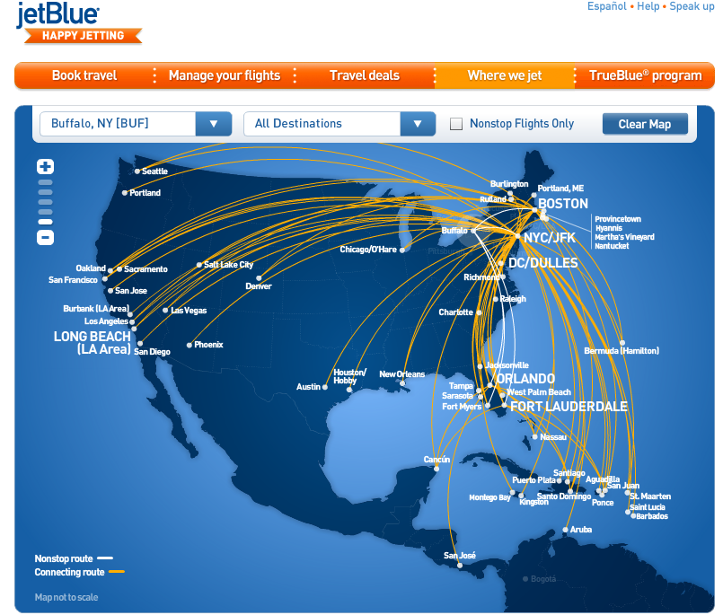
Graphs are omnipresent
Airline Route maps

Slide 5
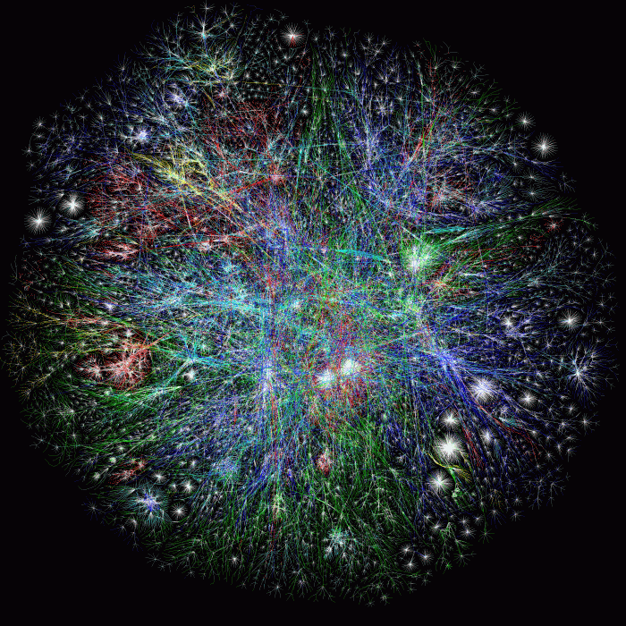
What does this graph represent?
Internet

Slide 6
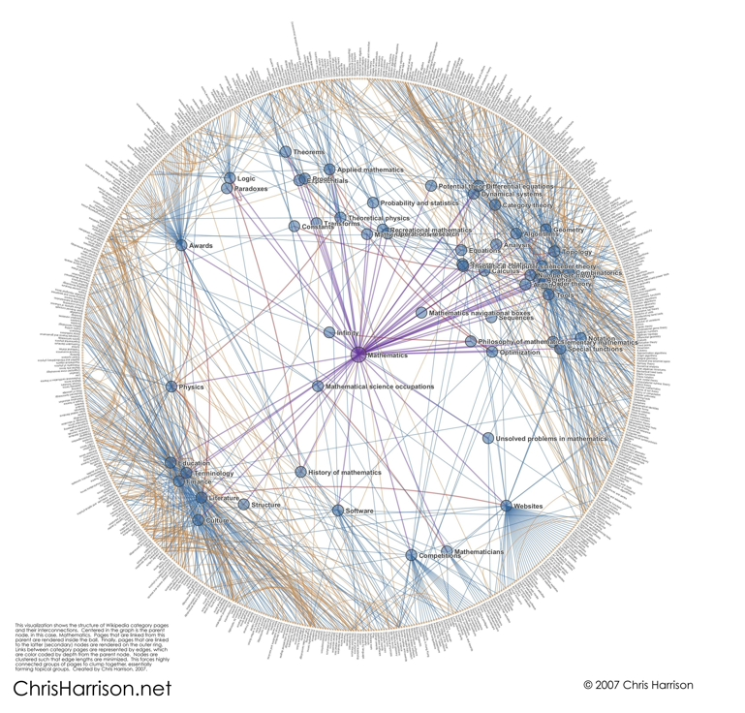
And this one?
Math articles on Wikipedia

Slide 7
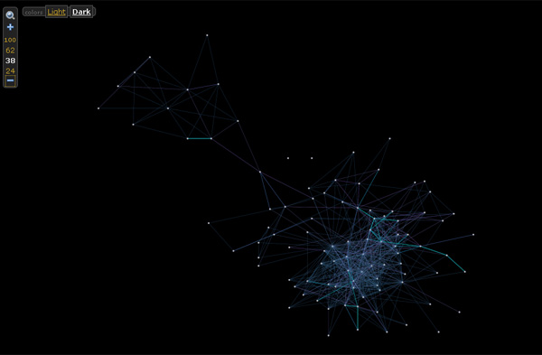

And this one?

Slide 8
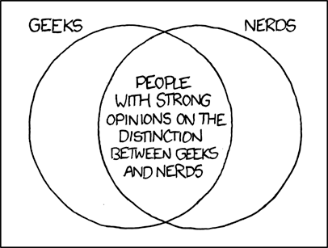
Basic Graph definitions
Formally define everything
http://imgs.xkcd.com/comics/geeks_and_nerds.png

Slide 9

Paths
,
Sequence of vertices connected by edges
Connected
Path length 3
,
,
,

Slide 10
Connectivity
u and w are connected iff there is a path between them
A graph is connected iff all pairs of vertices are connected

Slide 11


Connected Graphs
Every pair of vertices has a path between them

Slide 12
Cycles
Sequence of k vertices connected by edges, first k-1 are distinct
,
,
,

Slide 13
Tree
Connected undirected graph with no cycles

Slide 14

Rooted Tree

Slide 15
A rooted tree
How many rooted trees can an n vertex tree have?
AC’s child=SG
Pick any vertex as root
SG’s parent=AC
Let the rest of the tree hang under “gravity”

Slide 16
Prove n vertex tree has n-1 edges

Slide 17
Prove n vertex tree has n-1 edges
Pick an arbitrary node to be the root
Image every edge is directed towards the root
Every non-root node has 1 outgoing edge
There are n-1 non-root nodes
There are n-1 edges
1
2
3
4
5
7
8
6

Slide 18


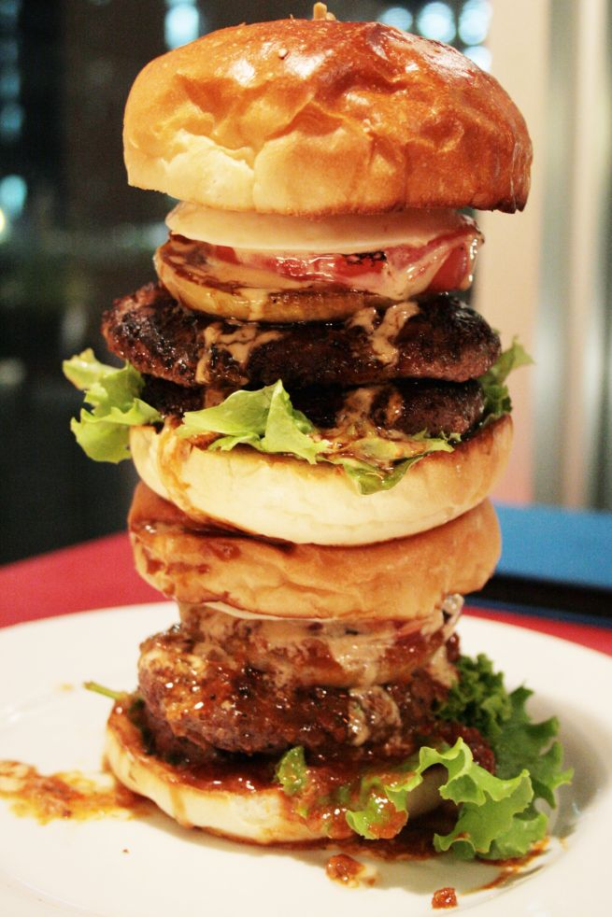
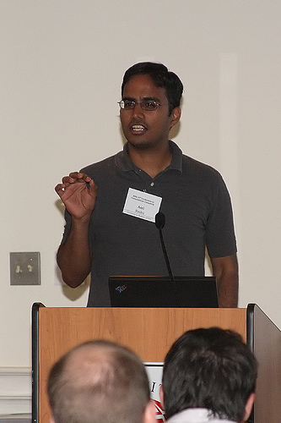

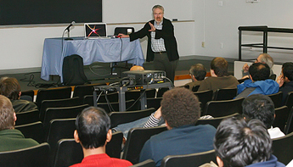
Directed graphs
Model asymmetric relationships
Precedence relationships
u needs to be done before w means (u,w) edge

Slide 19
Checking for a path by inspection

Slide 20
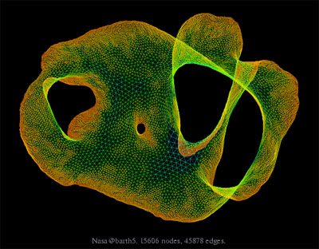
What about large graphs?
s
t
Are s and t connected?

Slide 21
Brute-force algorithm?
List all possible vertex sequences between s and t
O(n^{n}) such sequences
Check if any is a path between s and t

Slide 22

Algorithm motivation
all

Slide 23
Distance between u and v
Length of the shortest length path between u and v
Distance between and ?
3

Slide 24
Breadth First Search (BFS)
Is s connected to t?
Build layers of vertices connected to s
L_{j} : all nodes at distance j from s
L₀ = {s}
Assume L₀,..,L_{j} have been constructed
L_{j+1} set of vertices not chosen yet but are connected to L_{j}
Stop when new layer is empty

Slide 25
Exercise
Prove that L_{j} has all nodes at distance j from s

Slide 26
BFS Tree
BFS naturally defines a tree rooted at s
Add non-tree edges
L_{j} forms the jth “level” in the tree
u in L_{j+1} is child of v in L_{j} from which it was “discovered”
1
7
1
L₀
2
3
L₁
2
3
8
4
5
4
5
7
8
L₂
6
6
L₃

Slide 27
Connected Component
Connected component (of s) is the set of all nodes connected to s

Slide 28
Algo to compute the connected component of s?

Slide 29
Computing Connected Component
Explore(s)
Start with R = {s}
While exists (u,v) edge v not in R and u in R
Add v to R
Output R

Slide 30
Prove: Explore(s) = ConnectedComp(s)
Lemma 1: If w is in R then s is connected to w
Lemma 2: If s is connected to w then w is in R

Slide 31
BFS
all

Slide 32
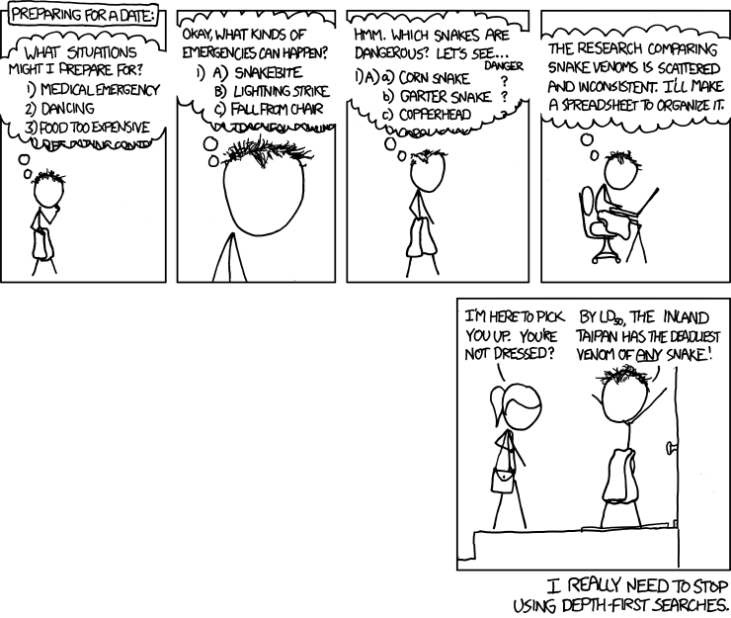
Depth First Search (DFS)
http://xkcd.com/761/

Slide 33
DFS(u)
Mark u as explored and add u to R
For each edge (u,v)
If v is not explored then DFS(v)

Slide 34
Why is DFS a special case of Explore?

Slide 35
A DFS run
Every non-tree edge is between a node and its ancestor
1
DFS(u)
1
7
u is explored
2
2
3
For every unexplored
neighbor v of u
8
4
DFS(v)
4
5
5
DFS tree
6
6
3
8
7

Slide 36
Connected components are disjoint
Either Connected components of s and t are the same or are disjoint
Algorithm to compute ALL the connected components?
Run BFS on some node s. Then run BFS on t that is not connected to s

Slide 37

Today’s agenda
Run-time analysis of BFS and DFS

Slide 38

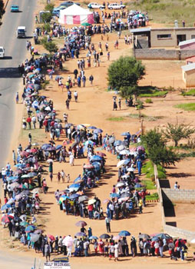
Stacks and Queues
Last in First out
First in First out

Slide 39
But first…
How do we represent graphs?

Slide 40
Graph representations
0
1
1
1
0
0
Better for sparse graphs and traversals
1
0
0
Adjacency matrix
Adjacency List
O(1)
(u,v) in E?
O(n) [ O(n_{v}) ]
O(n)
All neighbors of u?
O(n_{u})
O(n²)
Space?
O(m+n)

Slide 41
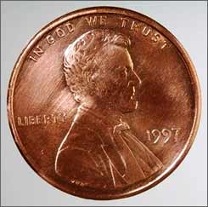
2 # edges = sum of # neighbors
2m = Σ_{u in V} n_{u}
Rest of the graph
Give 2 pennies to each edge
Total # of pennies = 2m
n_{v}=3
u
n_{u}=4
v
Each edges gives one penny to its end points
# of pennies u receives = n_{u}

Slide 42
Breadth First Search (BFS)
Build layers of vertices connected to s
L₀ = {s}
Assume L₀,..,L_{j} have been constructed
L_{j+1} set of vertices not chosen yet but are connected to L_{j}
Stop when new layer is empty
Use CC[v] array
Use linked lists

Slide 43
An illustration
1
2
3
4
5
7
8
6
1
7
2
3
8
4
5
6

Slide 44
Implementing DFS in O(m+n) time
Same as BFS except stack instead of a queue

Slide 45
A DFS run using an explicit stack
7
8
1
7
6
7
3
2
3
5
8
4
4
5
5
3
6
2
3
1

Slide 46
O(m+n) BFS Implementation
Input graph as Adjacency list
BFS(s)
Array
CC[s] = T and CC[w] = F for every w≠ s
Set i = 0
Set L₀= {s}
While L_{i} is not empty
Linked List
L_{i+1} = Ø
For every u in L_{i}
For every edge (u,w)
Version in KT also computes a BFS tree
If CC[w] = F then
CC[w] = T
Add w to L_{i+1}
i++

Slide 47
All the layers as one
BFS(s)
All layers are considered in first-in-first-out order
CC[s] = T and CC[w] = F for every w≠ s
Set i = 0
Set L₀= {s}
While L_{i} is not empty
L_{i+1} = Ø
For every u in L_{i}
Can combine all layers into one queue: all the children of a node are added to the end of the queue
For every edge (u,w)
If CC[w] = F then
CC[w] = T
Add w to L_{i+1}
i++

Slide 48
Queue O(m+n) implementation
BFS(s)
CC[s] = T and CC[w] = F for every w≠ s
O(n)
Intitialize Q= {s}
O(1)
While Q is not empty
Repeated at most once for each vertex u
Σ_{u} O(n_{u}) =
O(Σ_{u} n_{u}) =
O(m)
Delete the front element u in Q
For every edge (u,w)
Repeated n_{u} times
O(1)
If CC[w] = F then
O(n_{u})
CC[w] = T
O(1)
Add w to the back of Q

Slide 49
Implementing DFS in O(m+n) time
Same as BFS except stack instead of a queue

Slide 50
DFS stack implementation
DFS(s)
CC[s] = T and CC[w] = F for every w≠ s
Same
O(m+n) run time analysis as for BFS
Intitialize Ŝ = {s}
While Ŝ is not empty
Pop the top element u in Ŝ
For every edge (u,w)
If CC[w] = F then
CC[w] = T
Push w to the top of Ŝ

Slide 51
Finding cycles in O(n+m)
Run BFS or DFS
If an edge is considered and the node is already explored
That’s a cycle!

Slide 52
Directed graphs
Model asymmetric relationships
Precedence relationships
u needs to be done before w means (u,w) edge

Slide 53
Directed graphs
Adjacency matrix is not symmetric
Each vertex has two lists in Adj. list rep.

Slide 54
Directed Acyclic Graph (DAG)
No directed cycles
Precedence relationships are consistent

Slide 55
Topological Sorting of a DAG
Order the vertices so that all edges go “forward”

Slide 56
Today’s agenda
DAG ➔ topological sorting
Iteratively pick a node with no incoming edges

Slide 57
Run of TopOrd algorithm

